Slide 1
Analysis and Influence of Business Parameters on OTT Services
Diego Rivera Villagra
Télécom SudParis

Slide 2
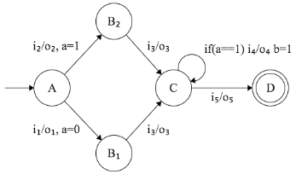
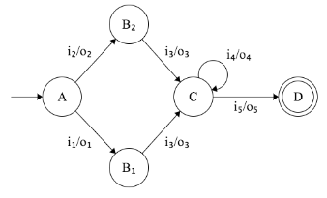
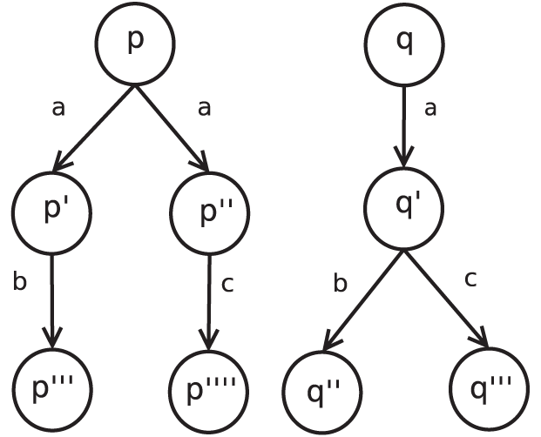
Business-aware QoE Evaluation Framework
Quality Indicators
L-equivalent generation Algorithm
QoE Value
OTT Service
EFSM Model
Augmented EFSM Model
QoE calculation Algorithm
QoE Model
Modeling
Augmenting
Computing

Slide 3
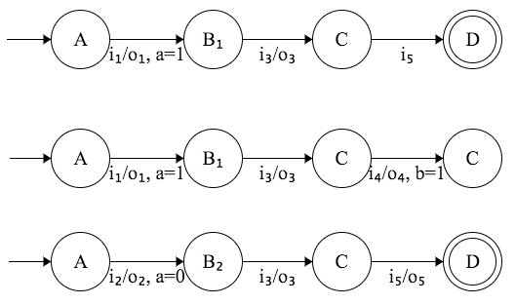
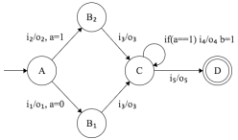
Implementation
Algorithm 1: Calculation of l-equivalent
Algorithm 2: QoE Calculation of scenarios
Framework Implementation
Fixed length
QoE Value
QoE Model
3
4
1.5
Montimage Monitoring Tool (MMT)

Slide 4
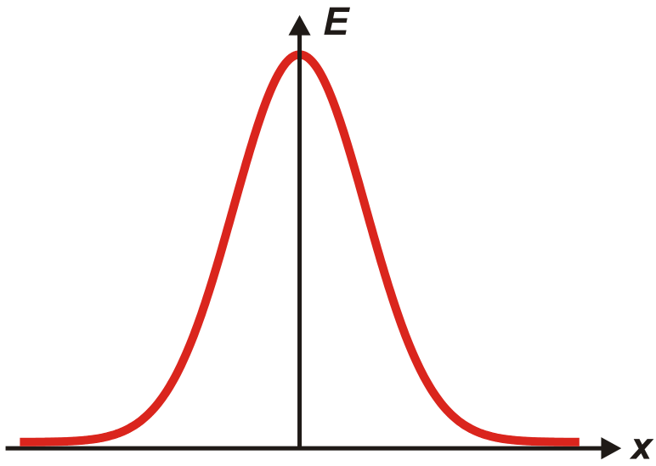
Analysis of an OTT Service
Algorithm for Computing the Number of Configurations
QoE characterization of the set of scenarios
Length | Avg conf. | Average QoE Distribution
 |  | ]0,1[ | [1,2[ | [2,3[ | [3,4[ | [4,5]
2 | 3 | 0 | 0 | 2 | 1 | 0
3 | 7 | 0 | 0 | 4 | 3 | 0
4 | 12.3 | 0.3 | 0 | 6 | 6 | 0
5 | 18.3 | 0.9 | 0.4 | 7 | 10 | 0
6 | 28.1 | 1.7 | 2.4 | 8 | 14 | 2
7 | 36.9 | 2.7 | 6.2 | 9 | 15 | 4
8 | 42.9 | 3.9 | 8.1 | 9.9 | 15 | 6
9 | 48.1 | 5.4 | 10.9 | 10.8 | 15 | 6
10 | 52.5 | 5.8 | 12 | 13.7 | 15 | 6
11 | 53.7 | 6 | 12 | 14.7 | 15 | 6
12 | 54 | 6 | 12 | 15 | 15 | 6
Possible Scenarios for a each possible length
Quality Indicators

Slide 5
Future Work
Validation of the framework
We are conducting experiments to validate the quality model.
In addition, these experiments aim to validate the introduction of business-related parameters.
Implementation of a monitoring tool
This QoE approach aims to be implemented as an extension of the Montimage Monitoring Tool (MMT)
This extension will allow to include the impact of business decisions when monitoring QoE on OTT services.

