Slide 1
Secure M2M communication in Wireless Sensor Network
Raul A. Fuentes Samaniego ¹
Prof. Ana R. Cavalli ¹
1 - Telecom SudParis, France

Slide 2
Secure M2M communication in Wireless Sensor Network
2011
Humans
<<
Objects/Things
Wireless Sensor Network
Internet of Things
First steps: Defining my testbed with open standards (FIT-LAB with Contiki or RIOT).
Challenge 1: Be able to monitor native traffic in WSN (IEEE 802.15.4/6LoWPAN).
Challenge 2: Be able to identify implantations that mitigates well known threats to M2M Security.
State of art: Focus on the detection of problems in their physical implementations (lowest layer) OR power performance, neglecting the security of the data being transmitted (“because is not new”).
My objective: Monitoring TO VERIFY an adequate implementation of secure M2M.
Presented by:Raul Armando Fuentes Samaniego
A world-wide network of interconnected objects uniquely addressable, based on standard communication protocols
Notes:
Internet of things: Has getting more an more relevance in the last years.
Since 6 years ago, there are more objects online than people and the numbers are getting bigger.
There are a great diversity of devices and platforms that referred themselves as IoT, each one with their own challenges.
My emphasis are on the WSN
Networks composed by sensors, in sometime in numbers of thousand.
The sensors can defined as constrained devices, small power supply, small amount of memory, small processors.
Yet, we expected them to collect different type of data, some of them trivial other can be delicate.
Due this, we need to try to achieve the Secure M2M, a hot topic

Slide 3
Many thanks!
Questions ?

Slide 4
DTLS (6) -Example of MMT-Security rules

Slide 5
ETSI: Well-known Threats related to secure M2M
ETSI Threat Number | Likelihood | Impact | Risk | Countermeasures
(ET8) Discover Keys by Eavesdropping on Communications Between Entities. | Substance | High | Critical | CM9, CM10, CM11, CM12, CM13
(ET10) Provisioning of non-Legitimate Keys 8.10.1. | Severe | High | Critical | CM9
(ET15) General Eavesdropping on M2M Service-Layer Messaging Between Entities. | Severe | High | Major | CM13, CM25
(ET16) Alteration of M2M Service-Layer Messaging Between Entities. | Substance | High | Major | CM9, CM13, CM25
“Likelihood” identifies the possibility of a threat of being exploited.
“Impact” identifies how the threat is exploited and a risk value based on the factor of likelihood.
“Risk” identifies the seriousness, of the, with minor, major and critical ranges.
NOTE: The original number of the threat (ET#) and the countermeasure ID (CM#) are respected.
Presented by:Raul Armando Fuentes Samaniego
Notes:
Risk analysis for this environment can be obtained by selecting specific threats and countermeasures defined by the ETSI and they are resumed in this table.
The following topics are being identified in the table:
The likelihood to exploit a specific threat, measured as low, moderate, substantial or severe.
The level of impact, this means how the threat is exploited and a risk value based on the factor of likelihood.
Seriousness, this means how the threat is exploited, with minor, major and critical ranges.
And from this table, we want to focus on the Countermeasures as shown in the next slides…

Slide 6
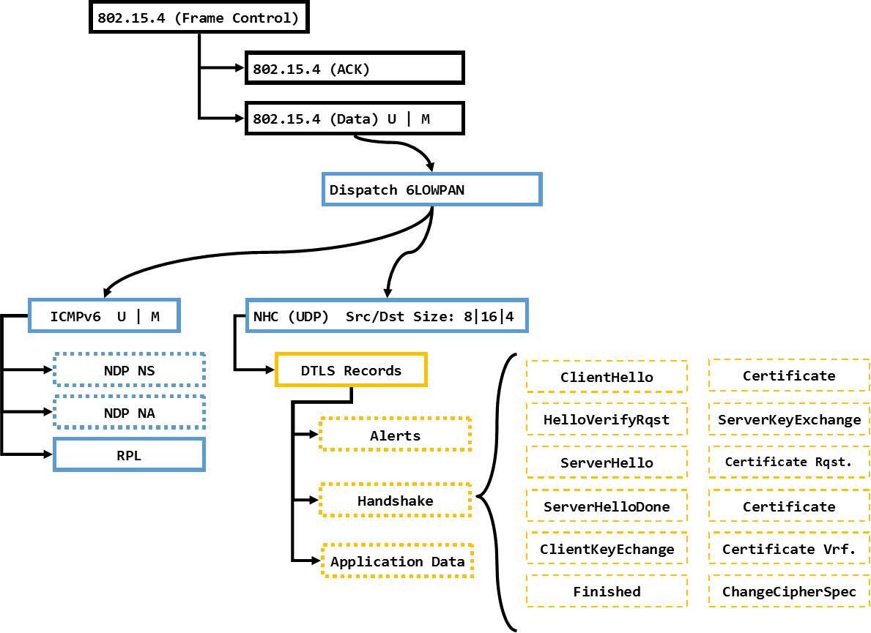
The Monitoring tool
Developing a native monitoring tool for the IEEE 802.15.4/6LoWPAN network able to track the full communication between the sensors.
Implementing the tool in our testbed.
Performing experiments for the DTLS in the 802.15.4/6LoWPAN.
Presented by:Raul Armando Fuentes Samaniego

